Slide 1


Random Variable

Slide 2
GATE DA Sample paper 2024
A class contains 60% students who are incapable of changing their opinions about anything, and 40% of students are changing their minds at random, with probability 0.3, between subsequent votes on the same issue. Then, the probability of a student randomly chosen voted twice in the same way is _______.

Slide 3
GATE DA Sample paper 2024
Let {O1, O2, O3, O4} represent the outcome of a random experiment, with P({O1})=P({O2})=P({O3})=P({O4}). Consider the following events: P={O1,O2}, Q={O2,O3}, R={O3,O4},S={O1,O2,O3}. Then, which of the following statements is true?
P and Q are independent
P and Q are not independent
R and S are independent
Q and S are not independent

Slide 4
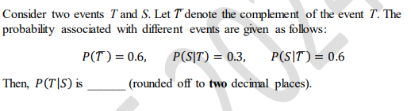
GATE DA 2024
Answer: 0.25

Slide 5
Random Variable

Slide 6
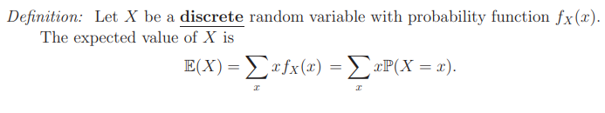
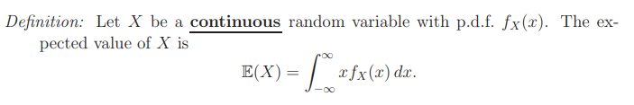
Expectation
The mean, expected value, or expectation of a random variable X is written as E(X) or µ_{X}

Slide 7
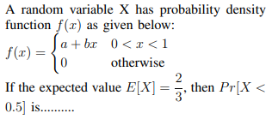

Slide 8
Properties of Expectation
Let g and h be functions, and let a and b be constants. For any random variable X (discrete or continuous), E {ag(X) + bh(X) } = aE { g(X) } + bE { h(X) } . In particular, E(aX + b) = aE(X) + b.
Let X and Y be ANY random variables (discrete, continuous, independent, or non-independent). Then E(X + Y ) = E(X) + E(Y ).
Let X and Y be independent random variables, and g, h be functions. Then E(XY ) = E(X)E(Y )
E [ g(X)h(Y ) ] = E [ g(X) ] E [ h(Y ) ] .

Slide 9

Variance
The variance of a random variable X is a measure of how spread out it is.

Slide 10
GATE CS 2011
If the difference between expectation of the square of a random variable (E[X²]) and the square of the expectation of the random variable (E[X])² is denoted by R, then? (A) R = 0 (B) R < 0 (C) R >= 0 (D) R > 0
Answer: (C)
The difference between (E[X²]) and (E[X])² is called variance of a random variable. Variance measures how far a set of numbers is spread out. (A variance of zero indicates that all the values are identical.) A non-zero variance is always positive.

Slide 11
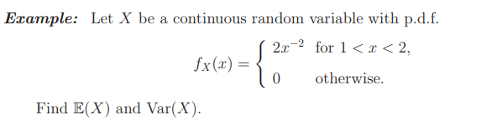

Slide 12
Properties of Variance
Let g be a function, and let a and b be constants.
For any random variable X (discrete or continuous),
Var { ag(X) + b } = a² Var { g(X) } .
In particular, Var(aX + b) = a² Var(X).
(ii) Let X and Y be independent random variables.
Then Var(X + Y ) = Var(X) + Var(Y ).
If X and Y are NOT independent,
then Var(X + Y ) = Var(X) + Var(Y ) + 2cov(X, Y ).

Slide 13

GATE DA Sample paper 2024
X is a uniformly distributed random variable from 0 to 1
The variance of X is
(A) 1/2
(B) 1/3
(C) 1/4
(D) 1/12

Slide 14
Joint Probability Distributions
We frequently need to examine two or more (discrete or continuous) random variables simultaneously.
In such situations the random variables have a joint distribution that allows us to compute probabilities of events involving both variables and understand the relationship between the variables
Notes:
For example, we might measure the height and weight of giraffes, or the IQ and birthweight of children, or the frequency of exercise and the rate of heart disease in adults, or the level of air pollution and rate of respiratory illness in cities, or the number of Facebook friends and the age of Facebook members.

Slide 15
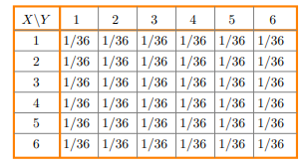
Example 1: Roll two dice. Let X be the value on the first die and let Y be the value on the second die
Notes:
the joint pmf is p(i, j) = 1/36 for all i and j between 1 and 6

Slide 16
In example 1, describe the event B = ‘Y − X ≥ 2’ and find its probability.
Notes:
the joint pmf is p(i, j) = 1/36 for all i and j between 1 and 6

Slide 17
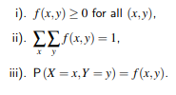
Joint Probability Mass Function (Joint PMF)
The function f(x, y) is a joint probability function, or probability mass function of the discrete random variables X and Y if

Slide 18
Let X be a coin flip, Y be a dice. Find the joint PMF.
Notes:
the joint pmf is p(i, j) = 1/36 for all i and j between 1 and 6

Slide 19

In the previous example, Let’s take head as 1 and tail as 0, define A = {X + Y = 3} and B = {min(X, Y ) = 1}. Find P[A] and P[B].
Notes:
the joint pmf is p(i, j) = 1/36 for all i and j between 1 and 6

Slide 20

Marginal Probability Mass Function (Marginal PMF)
The marginal distributions of X alone and Y along are, respectively

Slide 21
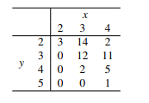
Example 2: Data supplied by a company in Duluth, Minnesota, resulted in the contingency table displayed as below for number of bedroom and number of bathrooms for 50 homes currently for sale. Suppose that one of these 50 homes is selected at random. Let X and Y denote the number of bedrooms and the number of bathrooms, respectively, of the home obtained.

Slide 22
Obtain the joint PMF of X and Y.
Find the probability that the home obtained has the same number of bedrooms and bathrooms, i.e., P(X = Y).
Find the marginal distribution of X alone.
Find the marginal distribution of Y alone.

Slide 23
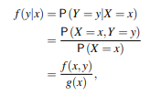
Conditional Probability Mass Function (Conditional PMF)
Let X and Y be two discrete random variables. The conditional distribution of Y given that X = x is
provided P(X = x) = g(x) > 0.
Similarly, we can find the conditional distribution of X given that Y = y .

Slide 24
Example 2: Data supplied by a company in Duluth, Minnesota, resulted in the contingency table displayed as below for number of bedroom and number of bathrooms for 50 homes currently for sale. Suppose that one of these 50 homes is selected at random. Let X and Y denote the number of bedrooms and the number of bathrooms, respectively, of the home obtained.

Slide 25
EXAMPLE . Refer to Example 2.
Find the distribution of X|Y = 2?
Use the result to determine f(3|2) = P(X = 3|Y = 2).

Slide 27
Let X∈{0,1} and Y∈{0,1} be two independent binary random variables. If P(X=0)=p and P(Y=0)=q, then P(X+Y≥1) is equal to __________.
(GATE ECE 2015 Set 2)
pq + (1 – p)(1 – q)
pq
p(1 – q)
1 – pq
Answer (d)

Slide 28
Independence
Jointly-distributed random variables X and Y are independent if their joint pmf is the product of the marginal pmf’s:
f(x, y) = f_{X}(x)f_{Y} (y)

Slide 29

Consider bivariate function
Is this function is pmf?
Marginal pmf of X
Marginal pmf of Y
Are X and Y independent?
P(X=Y)

Slide 30

Two discrete random variables X and Y have a joint distribution of
for x and y equal to 0, 1, or 2.
What should c be?
What is P(X ≤ 1,Y = 1)?
What is P(Y = 1)?
What is P(X ≤ 1|Y = 1)?
Notes:
c = 27.

Slide 31
Notes:
2.P(X ≤ 1,Y = 1) = 5/27
3. P(Y=1) = 1/3
4. P(X ≤ 1|Y = 1) = 5/9

Slide 32

Thank you

